Slide 1


Budget Calculator
Presentation/Website by Skye Yang
Notes:
Title
Welcome everyone, I’m Skye Yang and this is presentation, displaying my Budget Calculator page.

Slide 2

Notes:
EECU Slide
Many students in center for Advanced Research And Technology Web Design class were approached by Educational Employees Credit Union. And learned the importance of managing a budget as an adult.

Slide 3




Notes:
EECU requested a budget calculator
EECU asked for the students to created an ideal budget calculator page for their website to help users with their income. The students had to use their ideas, talents, and skills to create their budget calculator page but also for other students’ page.

Slide 4





Notes:
Project Manager and Developer
I then started my work on my budget calculator page, managing many colleagues to design my page, using my ideas and performing them into a page that could help users.

Slide 5









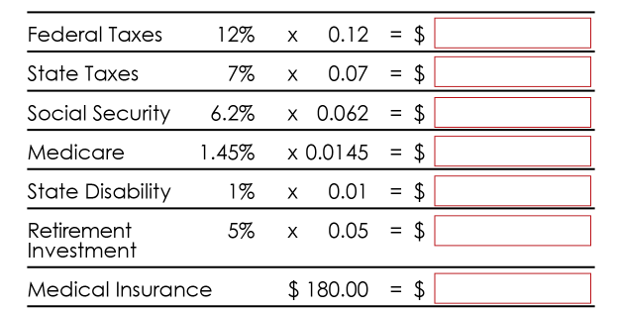


Notes:
My research
I first started my research, looking into other budget calculator pages in websites, gaining inspiration and knowledge. There were website that look and function nicely and some weren’t. Overall, they were helpful for my design. I also got some helpful resources from EECU. Like deposits and career incomes.

Slide 6
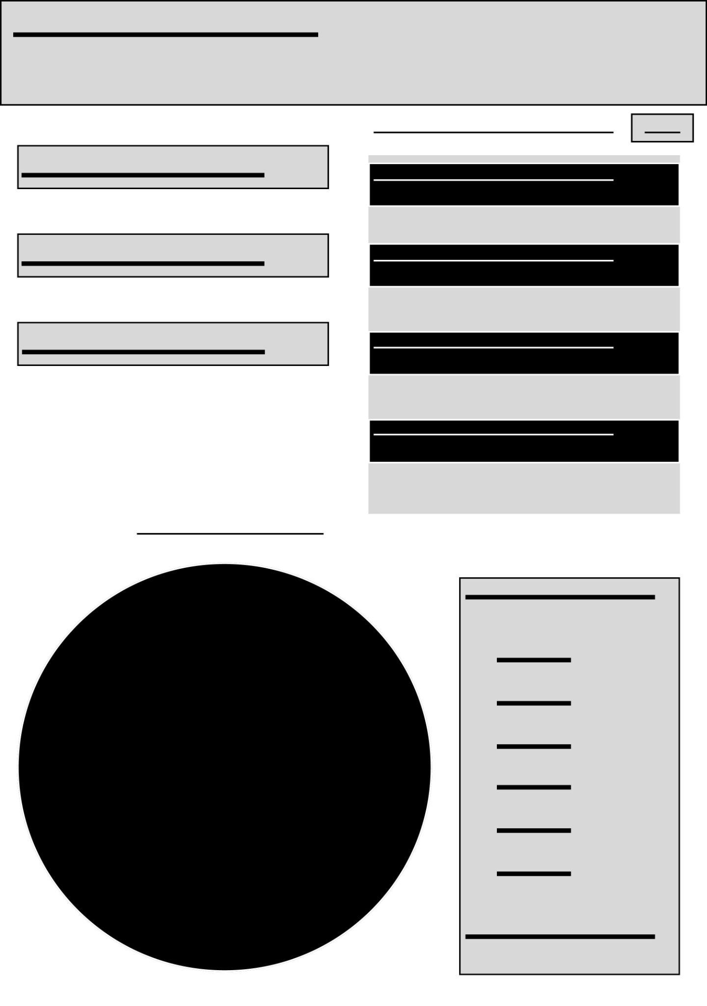




Notes:
Wireframe
After my research, I created a wireframe using Figma, a help website designing tool, to layout what the page will look like. I created my ideal format, text, and functions in my page. These features will be used on the website page.

Slide 7
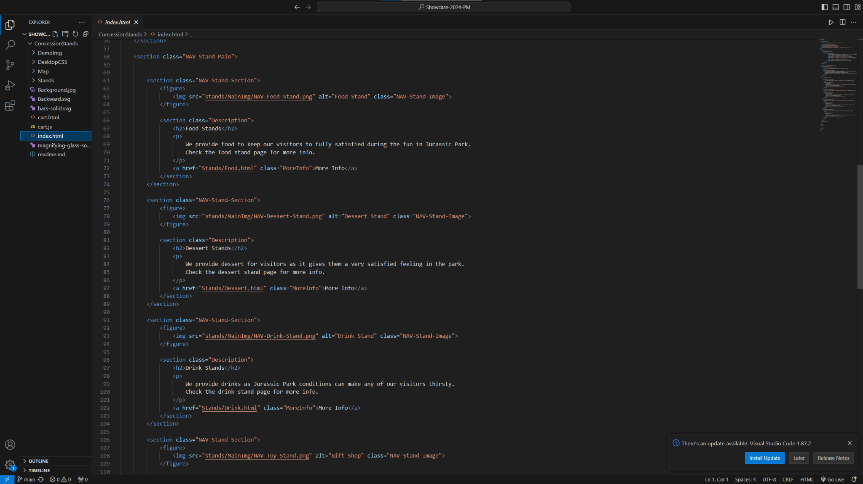

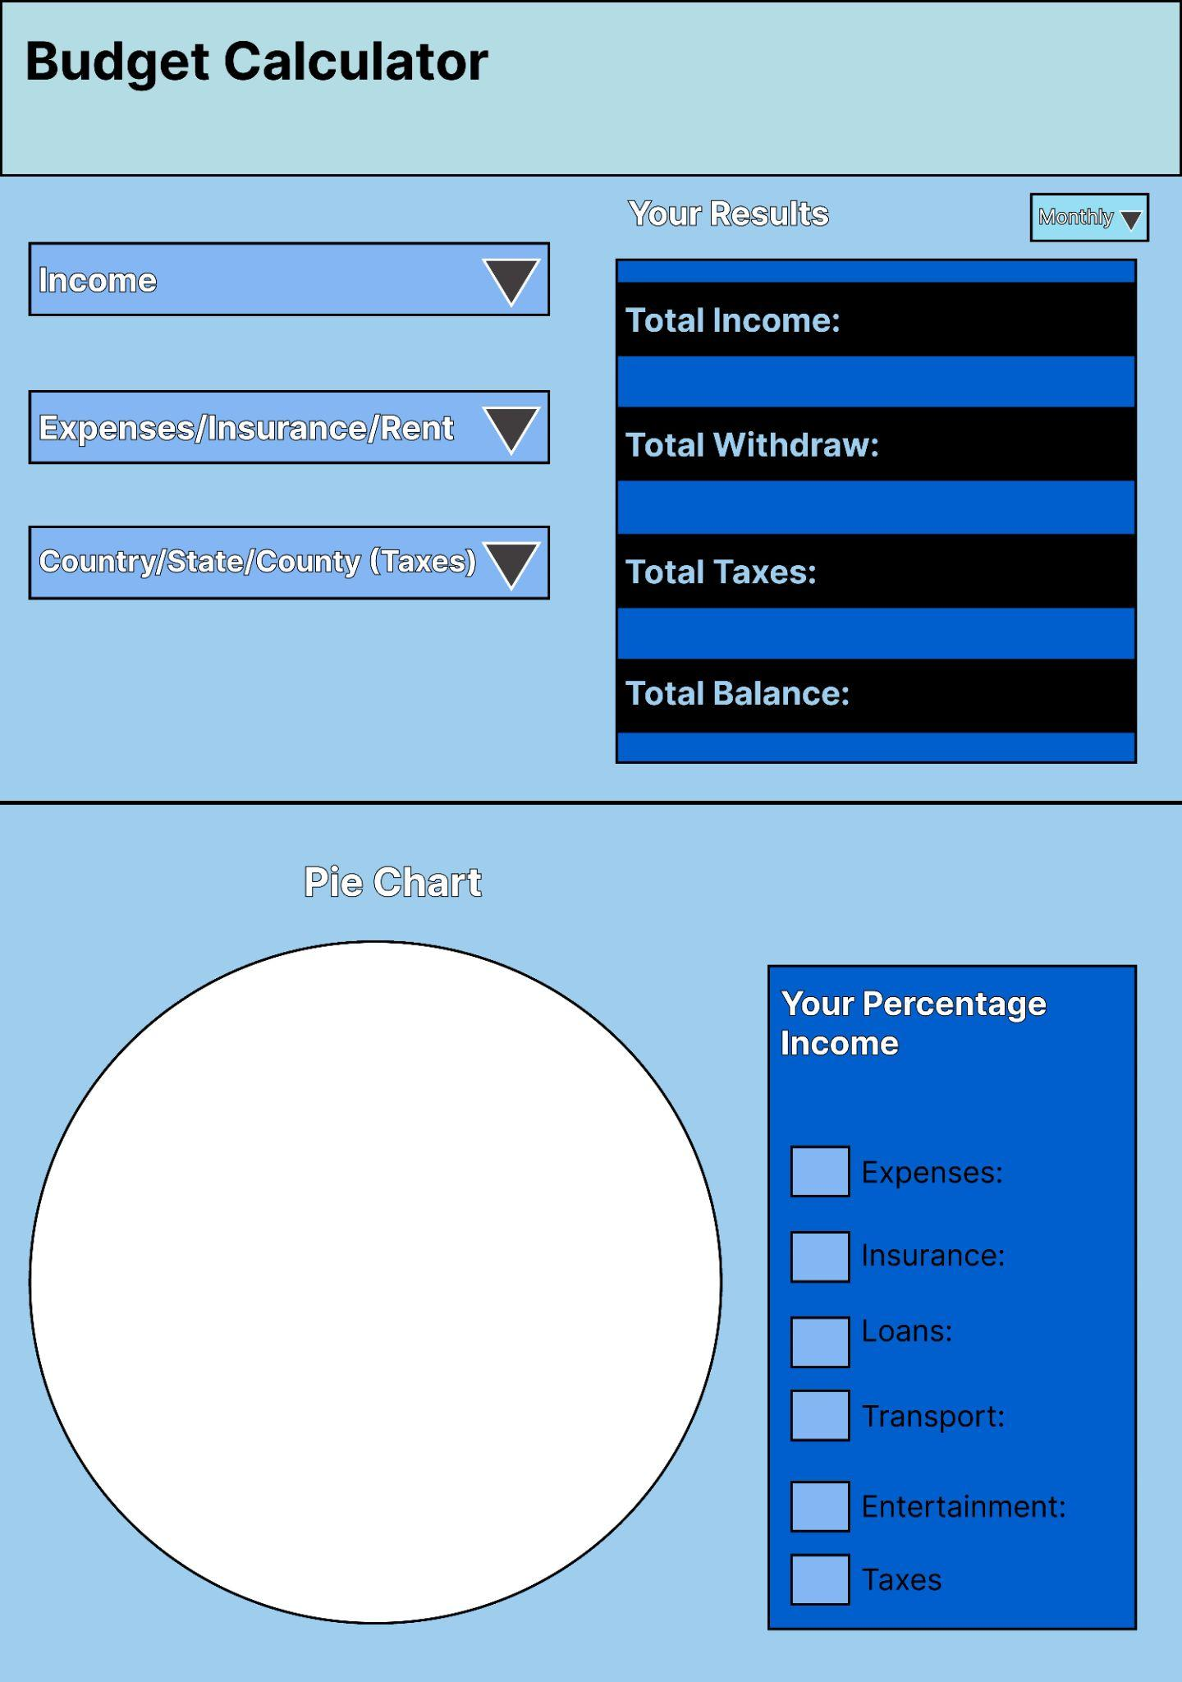

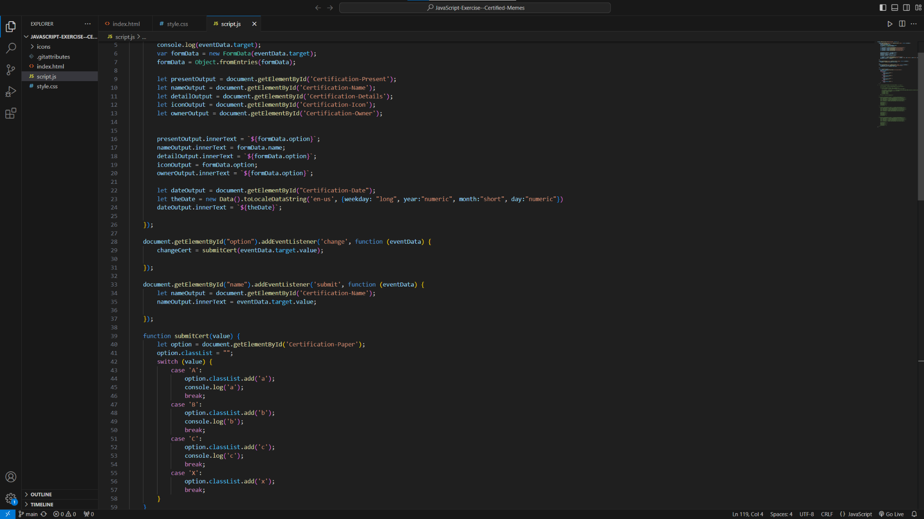

Notes:
Plan development I then begin to create the page, I lead my developers to format my content and make my page functional with HTML, CSS, and JavaScript. We used Github and Visual Studio Code to create the code for the page. Everyone had some effort and contributed on the page.

Slide 8

Notes:
experience as a project manager
My experience as project manager was very interesting, working with others was nice and helpful, everyone was different but put in their effort. But being a manager can be very stressful. I definitely need a break every few or so hours.

Slide 9


Notes:
standout developers and their contributions to my project
Leeana
I have standout contributions from three developers, first we have Leeana, she had the most work time compared to anyone. She helped with the CSS and HTML structures.

Slide 10

Notes:
standout developers and their contributions to my project
Nate
The second developer is Nate, just like Leeana, Nate also had the most work time compared to anyone. He also was a great help with HTML and CSS code.

Slide 11

Notes:
standout developers and their contributions to my project
Jack
Last developer is Jack, he was a great help with the CSS formatting and styling. I appreciate the help from all of the amazing developers who programed my page.

Slide 12
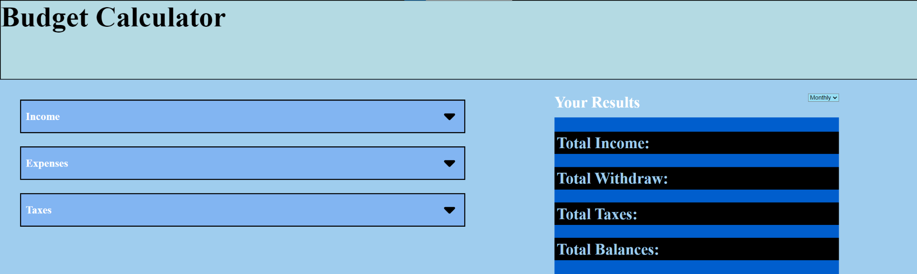
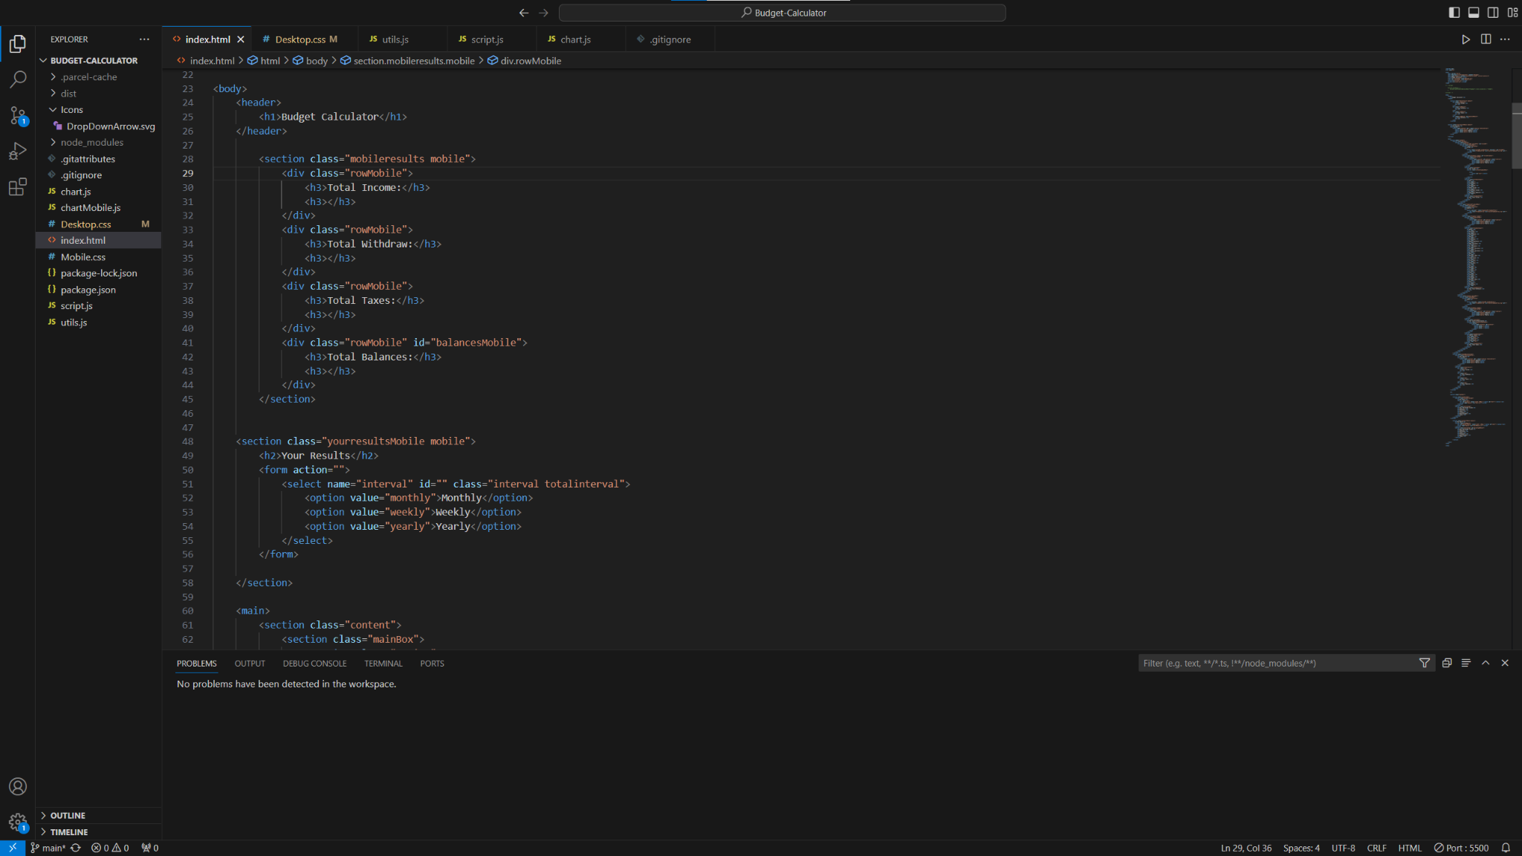
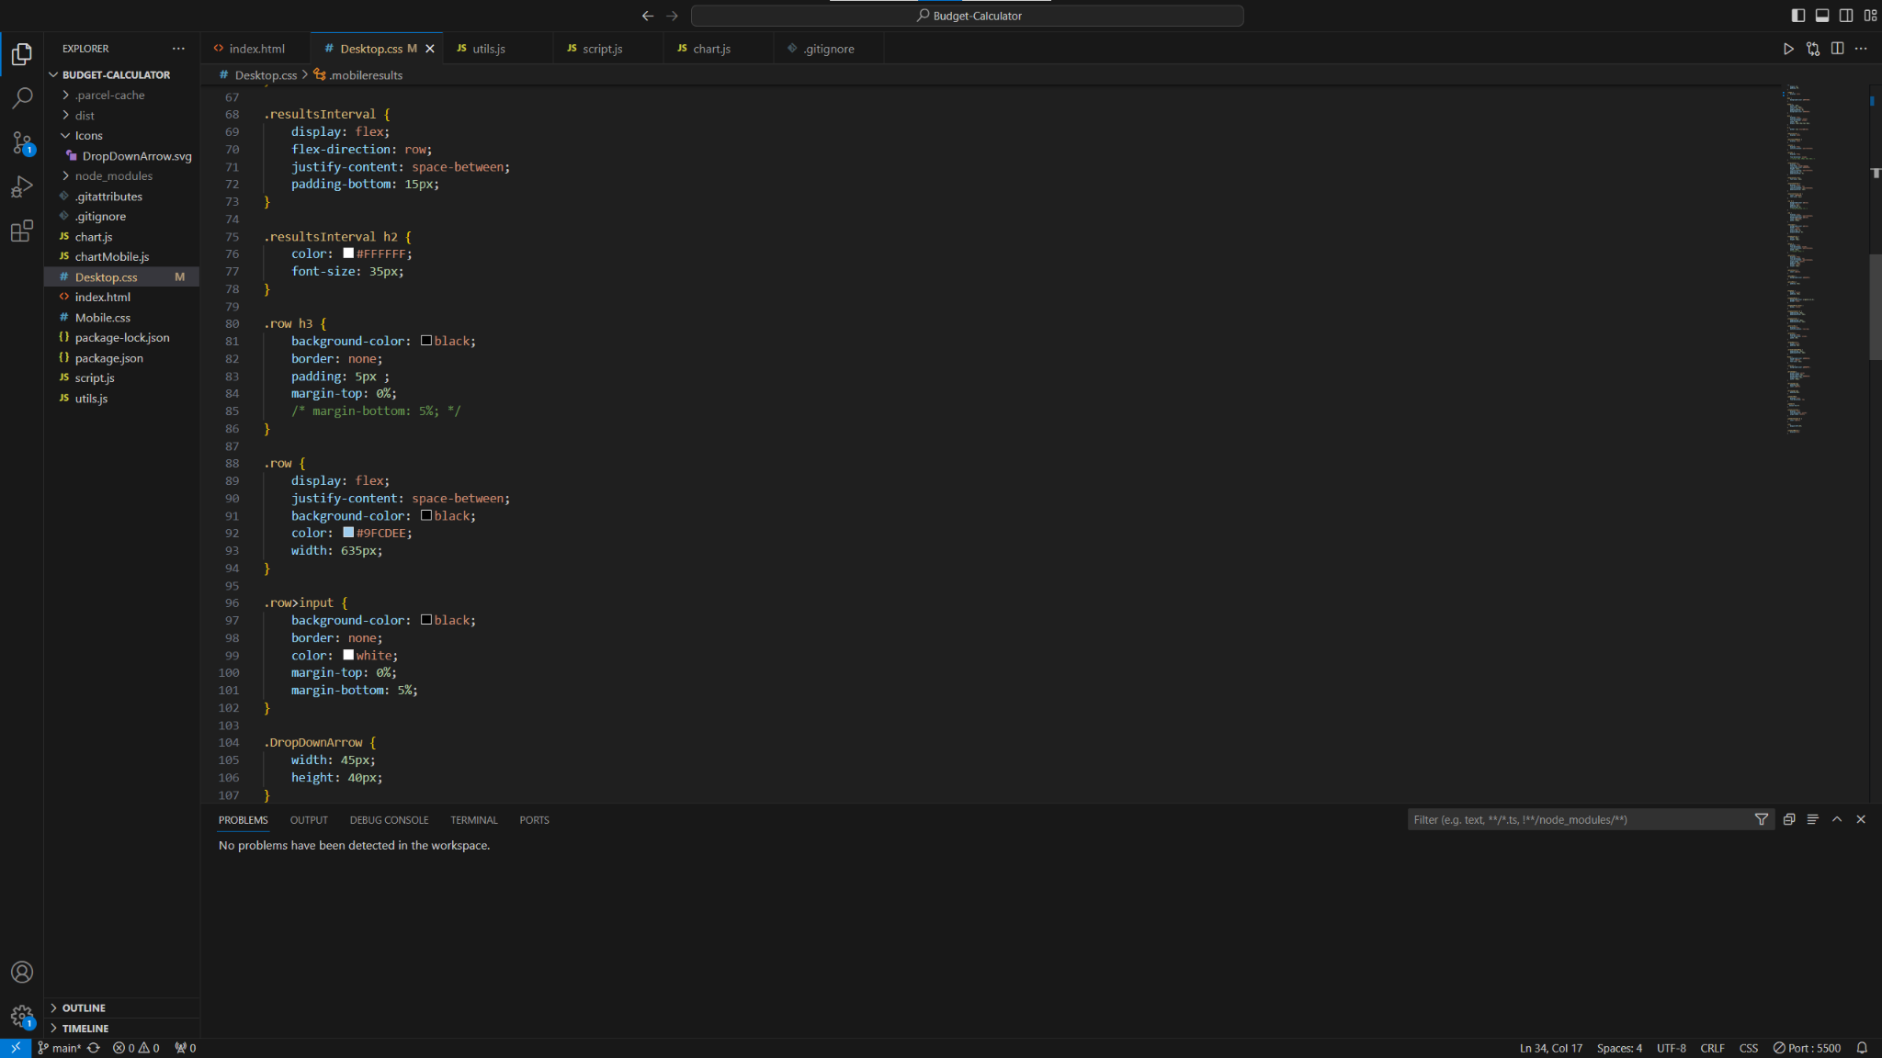
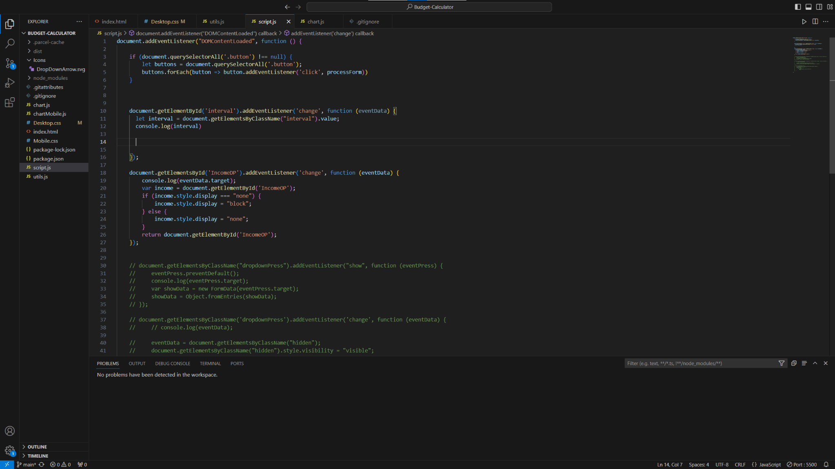
Notes:
Final Product
With the help of my developers, this is my final product. The text and sections are from the HTML. The formatting and styling came from CSS. The page is bright blue and has dropdowns revealing the options to the user.

Slide 13
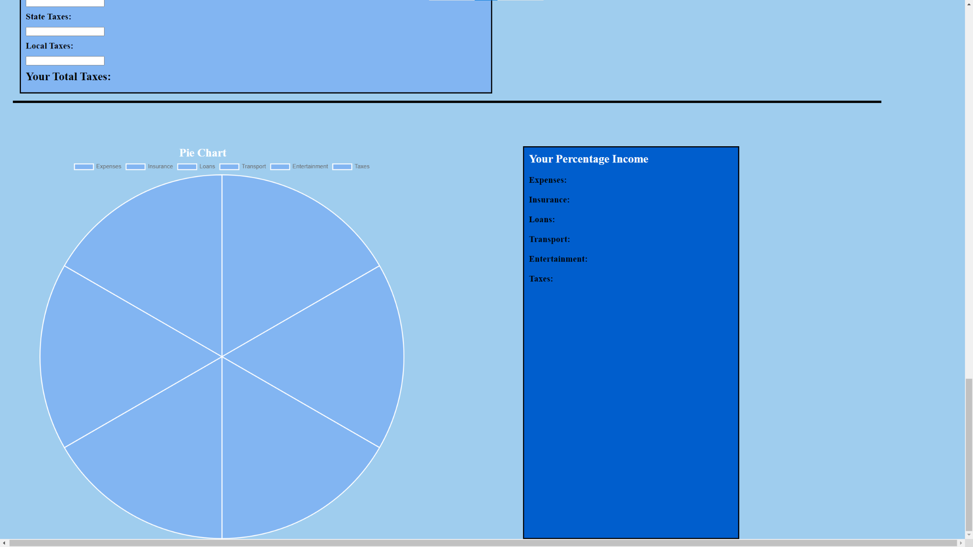
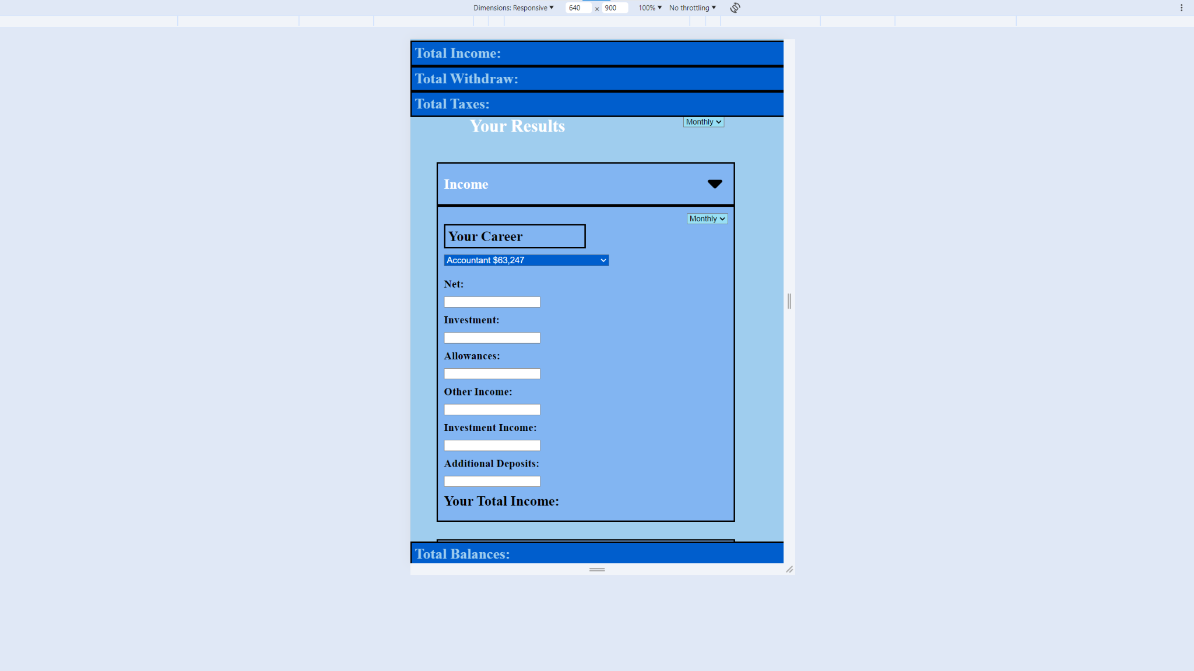
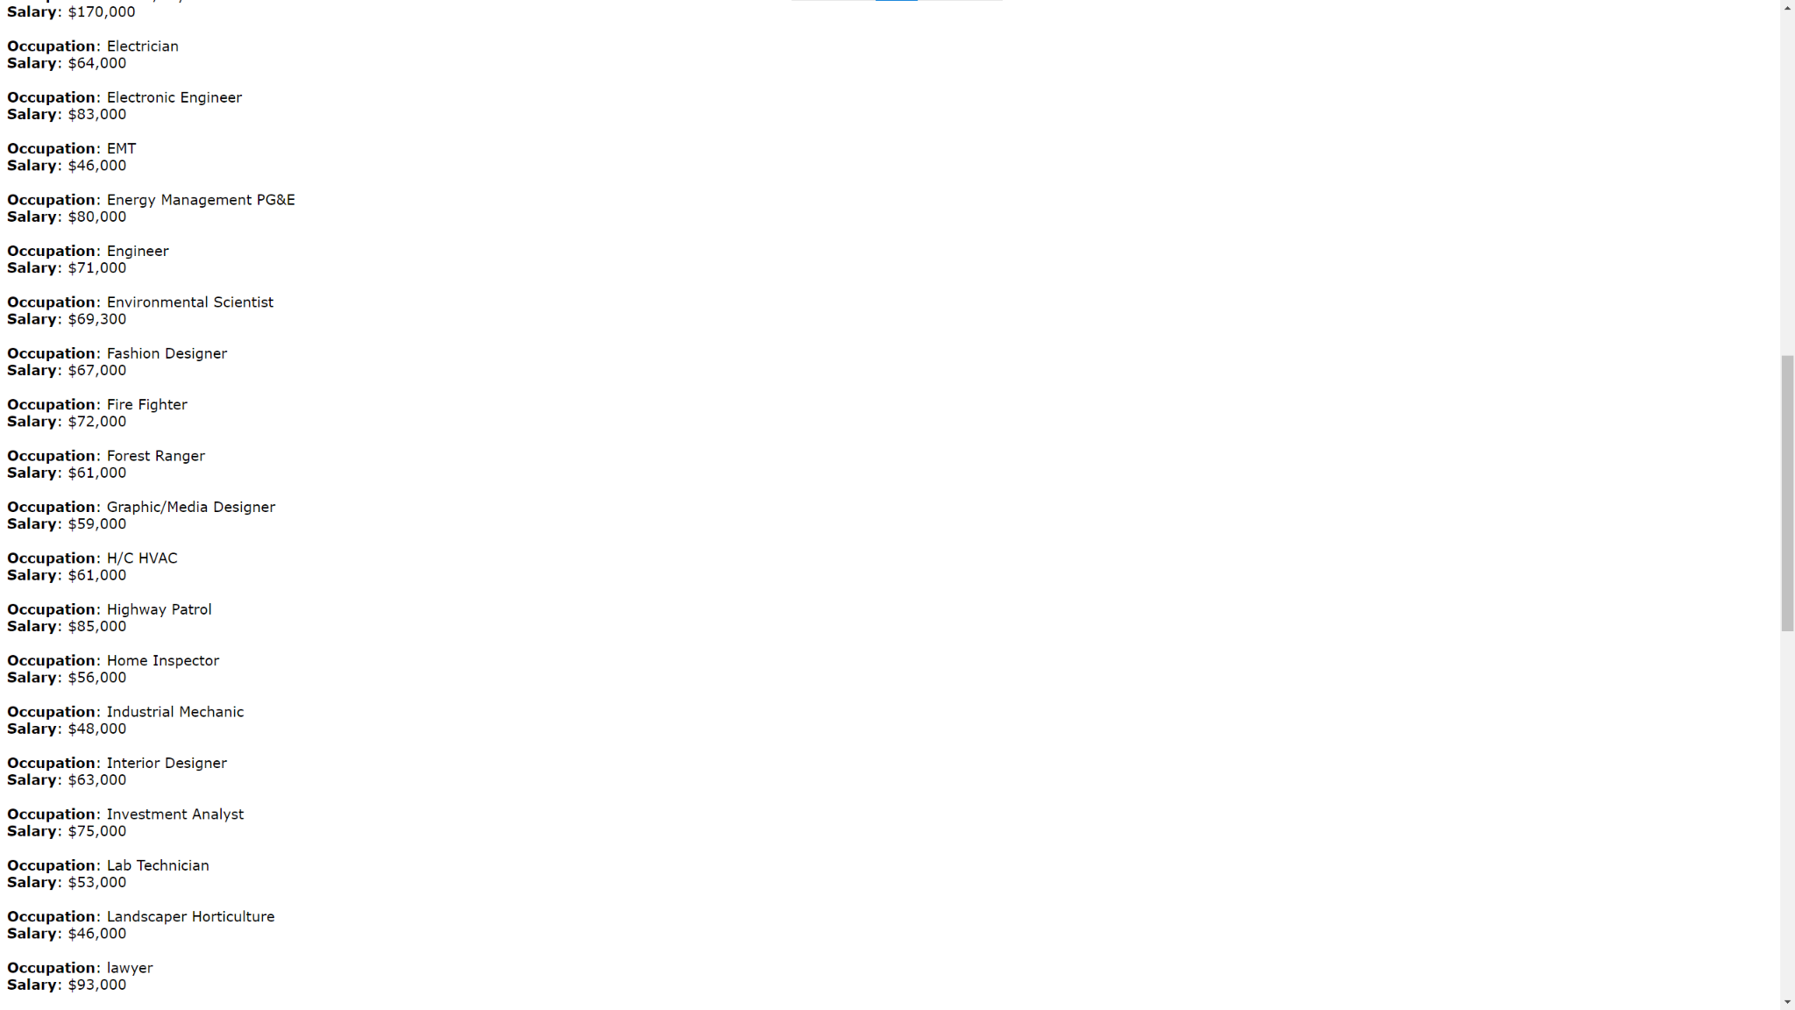

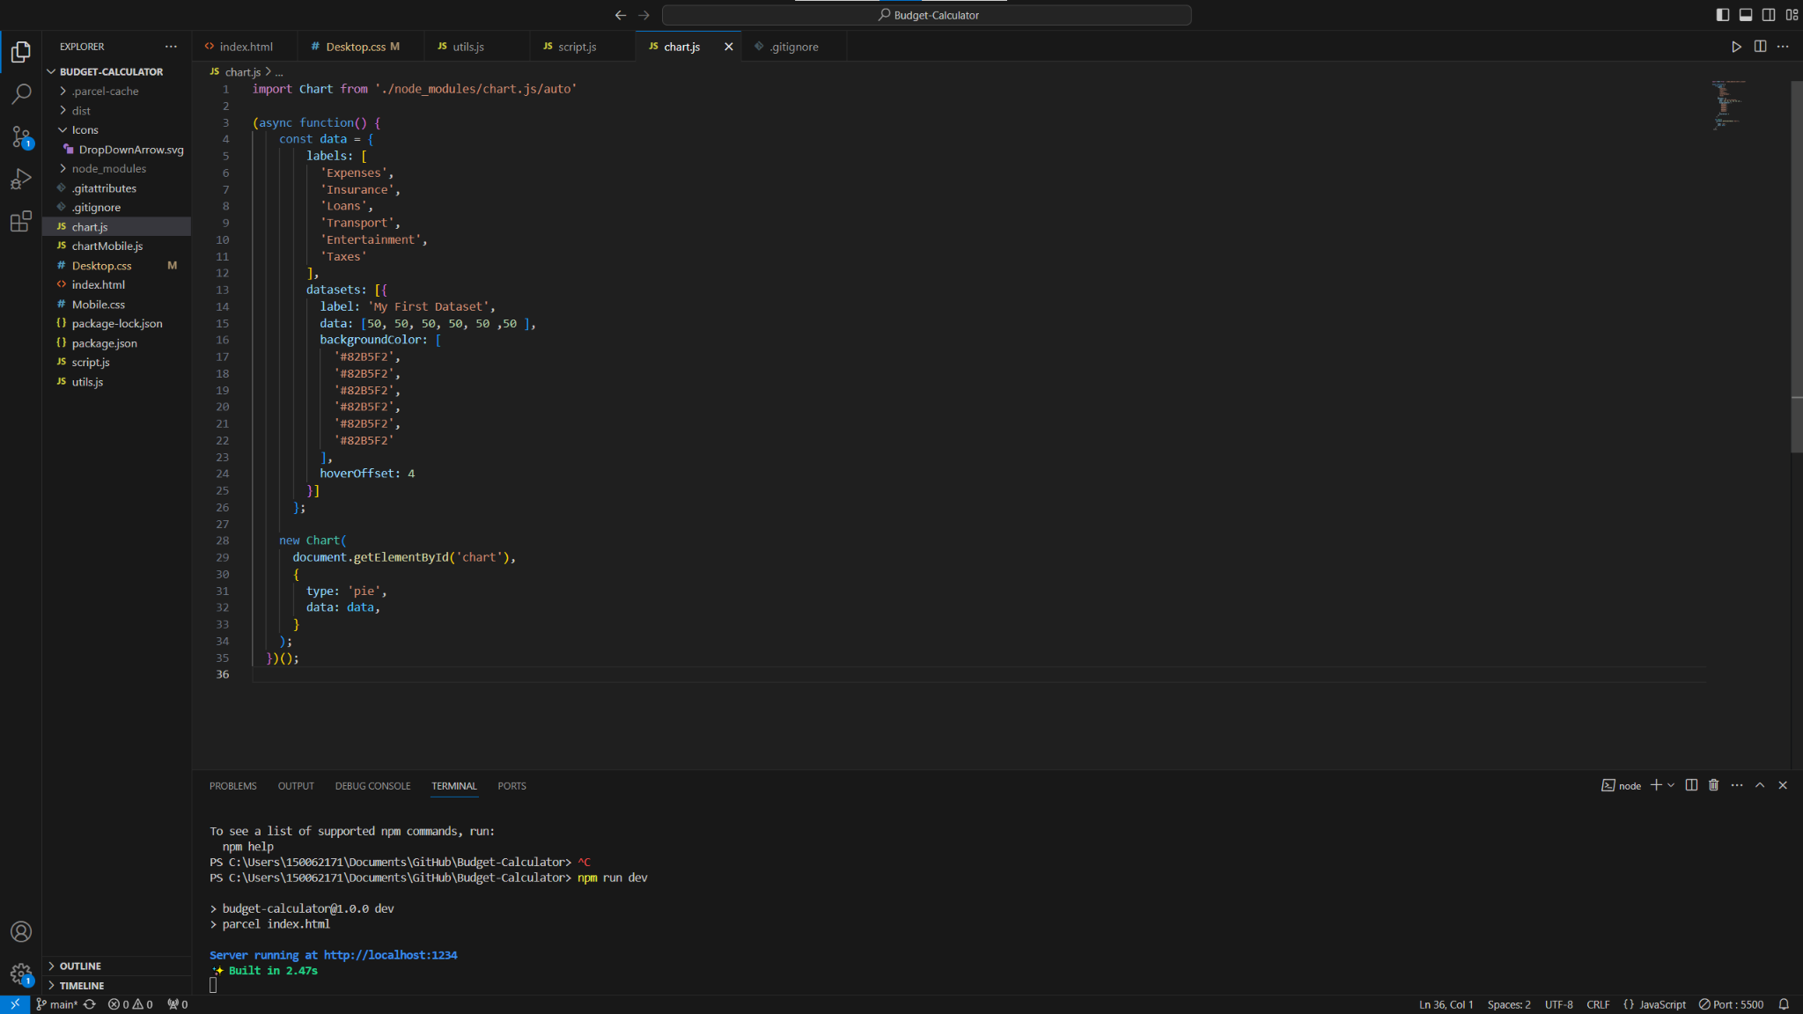

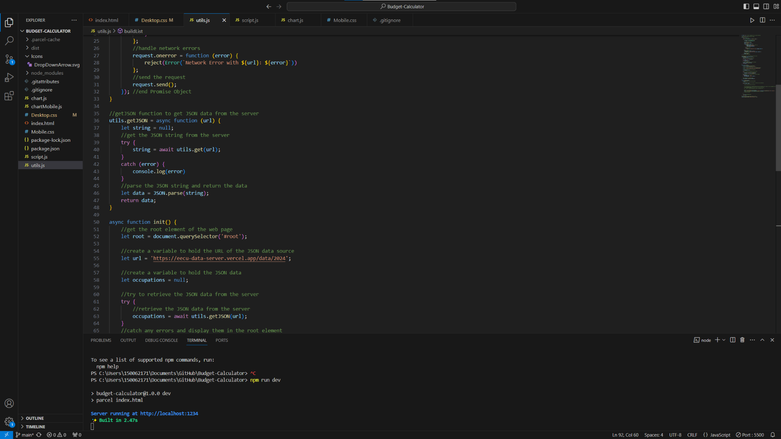
Notes:
Final Product Features
Also there was some good use of JavaScript, we created a pie chart using chart.js. And used the EECU API Data Server to show many careers and their salaries. And also to keep up with current salaries as markets and industries keep changing all the time. It also has a mobile version to help users who only have a phone.

Slide 14

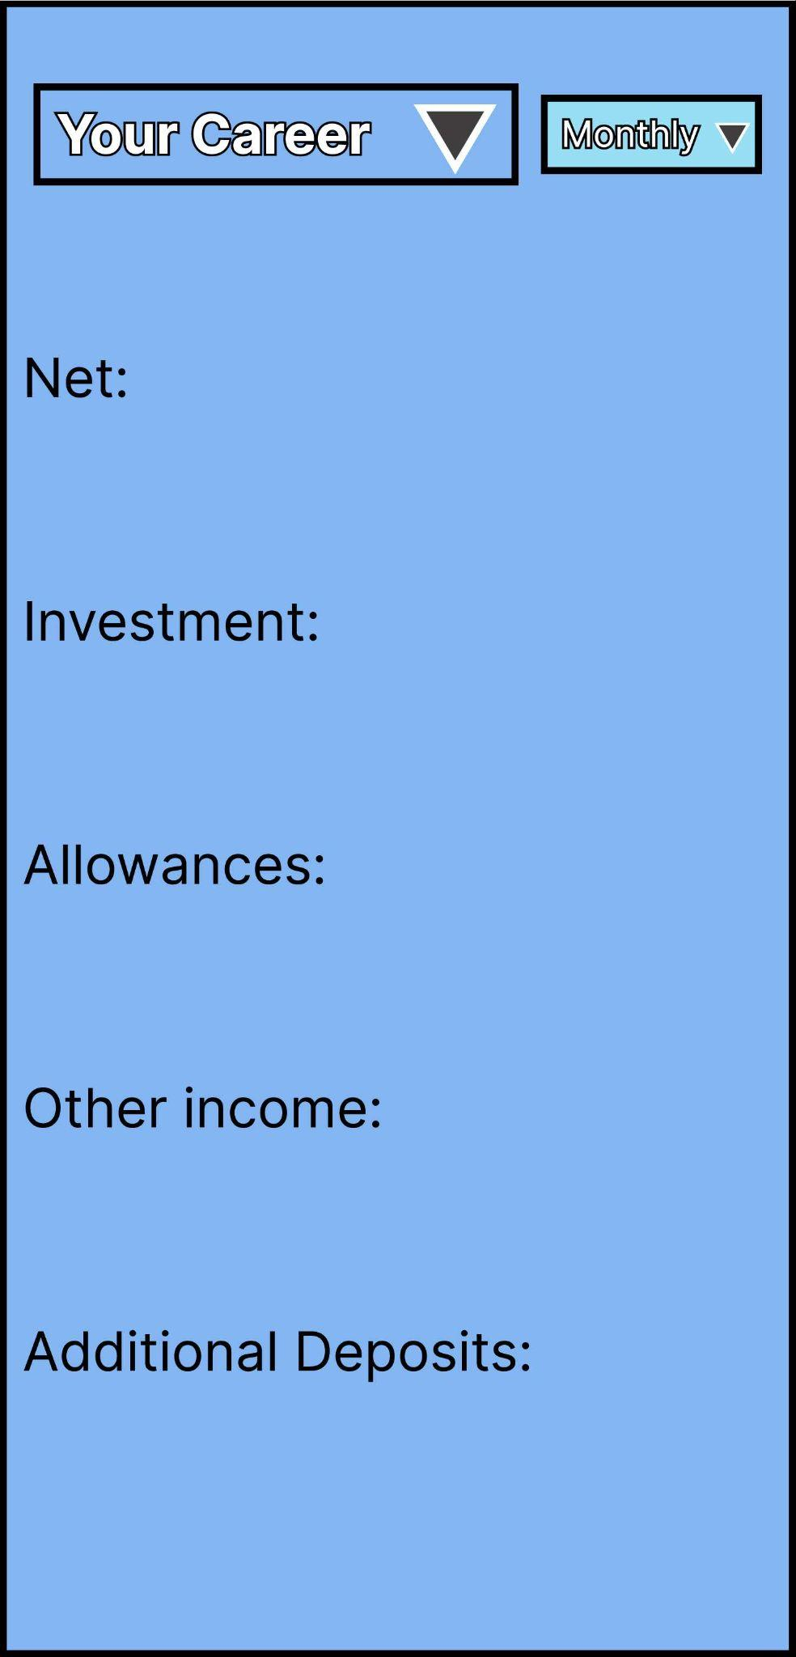
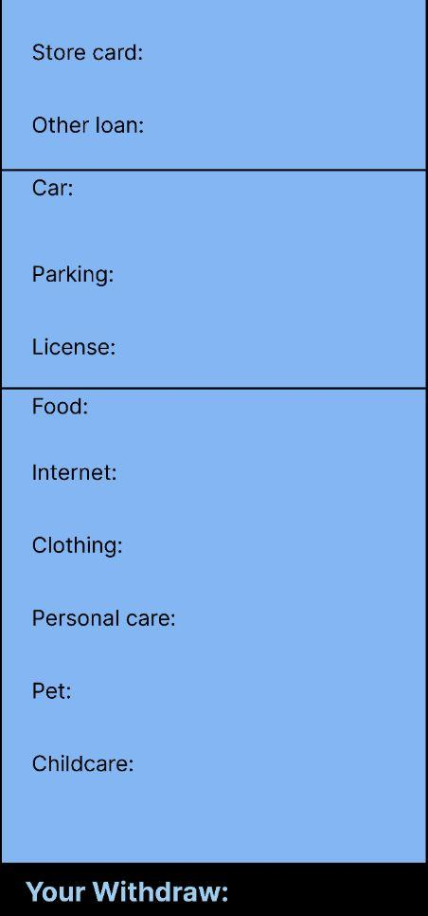
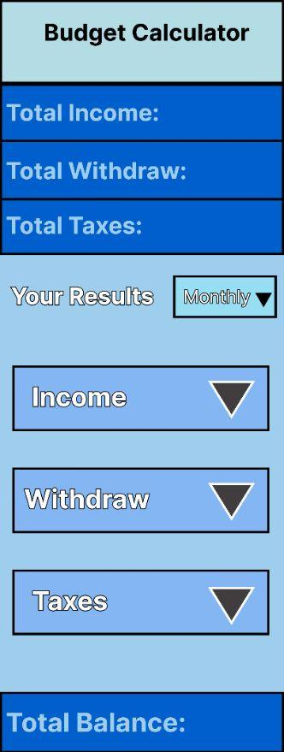
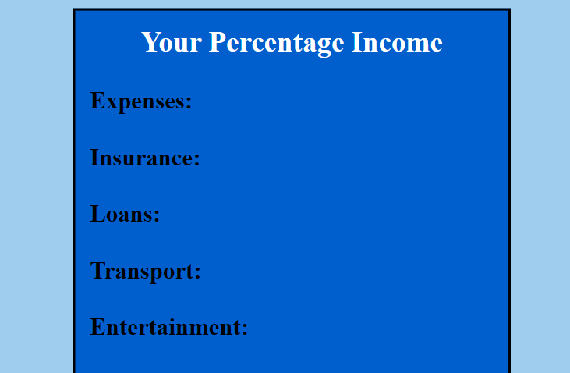

Notes:
Proudest part
I’m very proud with the look and structure of the page, it looks almost the same as the wireframe. I’m also happy that I got to work with others and see their talents and thoughts. I’m also proud that I’ve improved a lot from my class and will continue to improve my skills.

Slide 15

Notes:
Improved part
There are many things that need to be improved, the page needs more content to help users. Things like the mobile format needs to be fixed. And one final thing to mention is the JavaScript and functionally, if I had more time, I would focus on the JavaScript and make it a working calculator.

Slide 16
Notes:
End

